Slide 1
SAMPLE GRIDS & PERSONAS

Slide 2
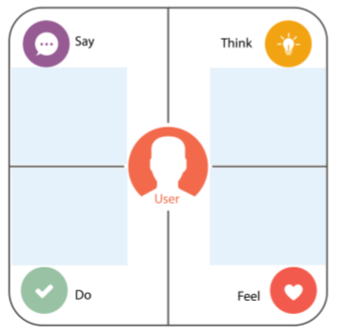

Fill the grid for the librarian
Dr Vyjanthi Iyengar: 52 Years, Head librarian
Notes:
Facilitator Guide
Type of Screen: Activity
Recommended Duration: 45 minutes
Aim and objective of this screen: This is a group activity in which participants will fill up the Empathy grid for the Librarian in the College Library Design challenge.
Say : This is a group activity. You will form four groups by starting to count from A to D and then repeating. Thus we will have four groups – A, B, C and D.
Do: Explain the following steps in the activity to them.
Refer to the Engage handouts shared with you earlier in which we show the interview of the librarian.
Based on that and the Engage and Immerse handout, fill up the Empathy grid for the Librarian in the College Library Design challenge.
Draw the grid simply on a blank paper using pen/pencil and ruler.
You will get 20 minutes for this.
Once done, each group will present their grid and answer questions from the other groups.

Slide 3
Capture insights
“I love campus life”
Why does it take so long to find a book here?
“The library is big, spacious, neat and clean”
Can’t the lights be a bit brighter?
“Need a quicker way to find a book”
I would rather search online than go all the way up to 5th floor.
“The lights are a bit low”
Parthiv Goenka, 3rd year Btech student
Prefers buying books online
Stressed about getting a campus recruitment
Enjoys spending time with friends in college
Frustrated at having to browse through rows of shelves in order to find a book
Does reference work for studies, but online
Uses mobile a lot, even to watch movies
Irritated at not being able to read the book titles in dim library lights
Notes:
Facilitator Guide
Type of Screen : Lecture and Practical
Recommended Duration: 20 minutes
Aim and objective of this screen: Explain how to conduct an immersion exercise.
Say : Once you have engaged, observed and immersed:
Note responses to interviews
Capture your observations
Note down your insights
A good way to capture insights is fill up the Say-Do-Think-Fell template, also known as the Empathy grid. The example here shows the insights we captured for a student in the College Library Design Challenge.
Do: Divide them into two groups and ask them to study the Empathy grid for the student by mapping it to the Engage interviews (shared earlier).
Ask: Can you identify how the responses captured in the engage translate to the insights captured in the “say” and “Do” sections on this grid? You need to infer what the user feels and thinks based on what you hear them say or do.

